Slide 1
CSE101-Lec#3
Constant
Variable
Expression

Slide 2
Outline
In this lecture we will study
Constant
Variable
Expression

Slide 3
Tokens
We have seen that Tokens are broadly classified as:
Identifiers
Keywords
Constants
Variables
Strings
Operators
Special character

Slide 4


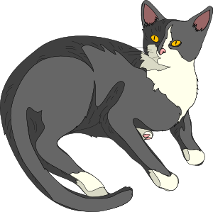



Constants
Lion
Spanner

Slide 5

Constants
The entity which do not change throughout the execution are called constants.
Types of constants:
Integer constant
Character constant
Floating point constants
String constants
Name of person remains same through out the life, example: Amit, Shubnam, etc.

Slide 6

Integer Constants
When the constant contains only digits without any decimal part
Floating Constant
Constants that contains number with decimal points
Example : 5;
-987;
Example : 3.14;
309.89

Slide 7
Character constants
Constants enclosed in single quotes(‘ ’).
It can be any letter from character set.
String Constants
Set of zero or more characters enclosed in double quotes (eg: “ ” )
It is represented as sequence of characters within double quotes.
Example : ‘\n’, ‘\t’ or ‘a’
Example : “This is C programming”

Slide 8
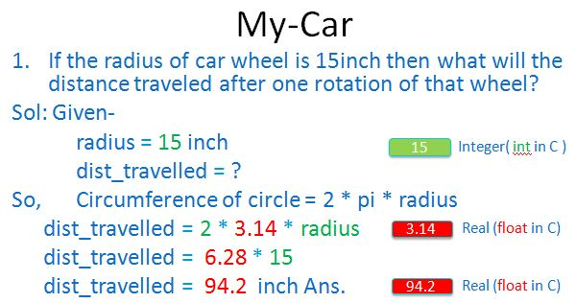
My-Car
In My-Car problem the constant value is 3.14 which is the value of pi and always same.
pi = 3.14
Therefore:
dist_travelled = 2 * pi * radius.
pi is a floating point constant.

Slide 9
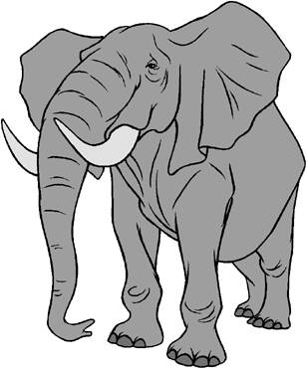



Variables
Animal
Tool

Slide 10

Variables
Variable is an entity which may change.
Variable is used to hold result and reserve memory for the data.
datatype variable_name;
The naming of variable is done by following the same rules of identifier naming.
Eg. What is your hobby?
The answer could be reading, dancing, drawing, etc.
So the answer to such questions may change during the life time of the person

Slide 11
Rules for naming a Variable
1. An variable name is any combination of 1 to 31 alphabets, digits or underscores.
2. The first character in the variable name must be an alphabet or underscore.
3. No blanks or special symbol other than an underscore can be used in an variable name.
4. Keywords are not allowed to be used as variables.

Slide 12
Variables
In My-Car problem the variable was
radius and dist_travelled
It can also be named as
radius_wheel or r1 or
car_wheel_radius
Distance or d1 or
dist_by_1rotation

Slide 13

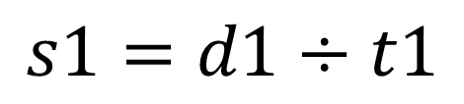
Variables
Let us build some variables:
For speed of car we need to know
Distance traveled
Time taken to travel the distance
Variables to be declared as
Speed, s1, speed_of_car
Distance, d1, dist
Time, t1, time_of_travel
Notes:
Variable is data name used for storing a data value

Slide 14
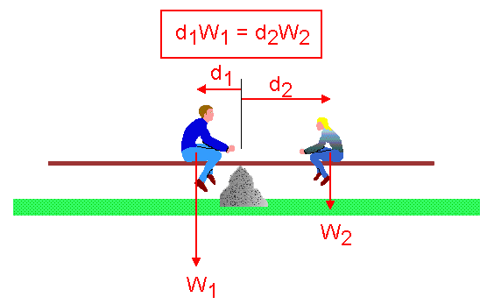
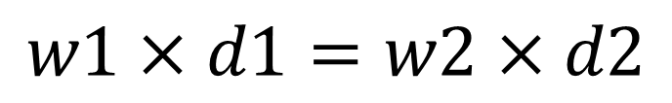
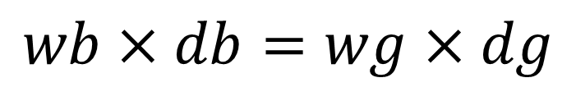
See-Saw
A bit more complex situation see-saw
Variables to be declared as
Weight_boy, w1, wb
Distance_boy, d1, db
Weight_girl, w2, wg
Distance_girl, d2, dg
It is to be assessed that at what distance 50Kg girl should sit in order to balance a boy of 70Kg sitting 2m away from the center ‘o’
Notes:
Variable is data name used for storing a data value

Slide 15
Variable Initialization
Assigning some value to the variable at time of creation of variable is known as variable initialization.
datatype variable_name = value;
Example: int radius= 15;
float pi = 3.14;
char grade = ‘A’;
Notes:
During declaration no memory space is allocated to an identifier.
Definition of identifier means the declaration of identifier + reservation of space for it in memory

Slide 16
What are the entities whose values can be changed called?
a) Constants b) Variables c) Modules d) Tokens

Slide 17
What are the entities whose values cannot be changed called?
a) Constants b) Variables c) Modules d) Tokens

Slide 18
Which of the following is true for variable names in C?
A. Variable names cannot start with a digit B. Variable can be of any length C. They can contain alphanumeric characters as well as special characters D. Reserved Word can be used as variable name

Slide 19
Which of the following cannot be a variable name in C?
A. TRUE B. friend C. export D. volatile

Slide 20
Expressions
Expressions are the statements or the instruction given to computer to perform some operation.
Every expression results in some value that can be stored in a variable.
Following are few example of expressions in program:
Expression to calculate speed of a car.
Speed=distance/time
Expression to find similarity of two things.
c=value1>value2
Notes:
A=b+c….three operands and 2 operators

Slide 21
Expressions in C are basically operators acting on operands.
An operand is an entity on which operation is to be performed.
An operator specifies the operation to be applied on operands.
Expressions are made of one or more operands.
Statements like :
a = b + c,
++z
300 > (8 * k)
Example: addition of two numbers, 5+8, these numbers will be operands.
Example: The addition, subtraction, etc will be operators

Slide 22
Types of Expressions
The type of expression depend upon the type of operator used in the expression.
It can be:
Arithmetic operators.
3 + 6 = 9
4 * 2 = 8
Relational or logical operators.
height_boy>=height_girl
Increment and decrement operator.
count=count++

Slide 23
What is the output of this program?
void main()
{
int x = 10;
float x = 10;
printf("%d", x)
}
A. Compilations Error
B. 10
C. 10
D. 10.1

